Slide 1
Settlers of Stepán
Aaron Dorrance, Jack Edwards, Kyle Hilbert, Sarah Holtz, James Libbey
Notes:
James

Slide 2
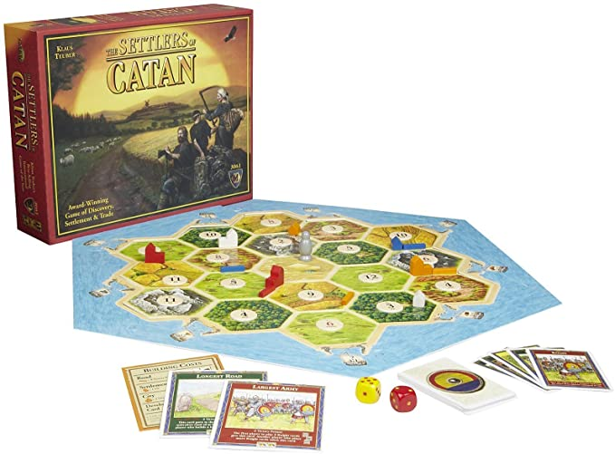
Introduction
Settlers of Catan is a multiplayer board game
Players “settlers” attempt to build and develop cities through trading and acquiring resources
We would like to design and build an electronic version, which will improve upon the game’s current flaws
Notes:
James

Slide 3
Problem Description
Notable difficulties do exist, which increase game difficulty. Ideally, these difficulties will be addressed
Determining a strong starting position can be difficult for beginners, placing them at an early disadvantage
Players commonly forget to collect resources when their number is rolled
Rules mistakes are not uncommon, but are incredibly difficult to correct
Pieces are incredibly easy to lose, which nearly ruins gameplay
Notes:
Kyle

Slide 4
Proposed Solution
Create an automated board, which will facilitate most game functions such as...
Select automated starting positions - “Quick Start”
Die rolling system
Automatic resource distribution/management system
Including “Longest Road” and “Largest Army”
Easier construction of roads, settlements, and cities
“Failsafes” to prevent rule breaks
Notes:
Kyle

Slide 5
Demonstrated Features
The aforementioned features resolve the problems:
"Quick Start" helps new players
Automatic resources stops forgetfulness
"Failsafes" prevent accidental rules violations
Small pieces are eliminated
Notes:
Sarah

Slide 6
Available Technologies
Player input
Buttons
Switches
Joystick
Individual resource display
LCDs
Internal processing of the rules and board state
PIC microcontrollers
[code]
Raspberry Pi? (for distributed I/O or processing)
The game board
LEDs
7 Segment Displays
3D Printer? or other custom plastic for enclosure
Notes:
Jack

Slide 7
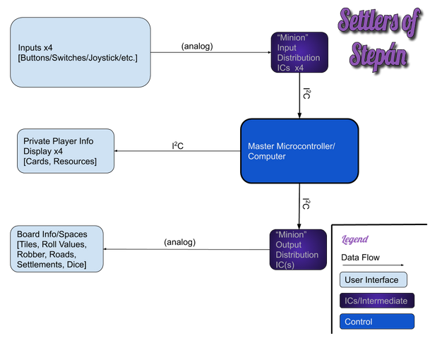
Notes:
Aaron Dorrance

Slide 8
Engineering Content
Player Input
Circuit with all the buttons, switch, and joysticks that the player can interact with
Connecting all the input to intermediate Microcontrollers (To have enough pins)
Main Controller/Computer
Receives the input from input Microcontrollers
Keeps track of game state and game rules
Prints to individual player display through I²C
Controllers output Microcontrollers through I²C
Individual Player display
LCD screen which displays resource and card info of each of the players
Game Board
LEDs that mark roads and settlements
MOAR LEDs and 7 segment displays that mark tiles
intermediate Microcontrollers to interface with all these (To have enough pins)
Notes:
Aaron Dorrance

Slide 9
Conclusions
Improving an existing design with substantial flaws in practical use
Can be broken up into reasonable functional blocks
Design challenges:
Large-scale output, efficiency of microcontroller I/O
Control mechanisms, distribution of per-player controls vs. per-game controls
Physical design is important in this application, PCB design has to be meticulous
User interface is top priority; selection of microcontrollers and interface components must be optimized
Notes:
James

